Slide 1
Cross Validation (CV) and workflow
DATA
Test
Training
VAL
VAL
VAL
Average
VAL
VAL
*VAL = validation set

Slide 2
kNN algorithm
Testing set
kNN (Training)
kNN (Testing)
Parameter Optimization
Accuracy
?
X
Error
X
k | 1 | 2 | … | 5
Pred |  |  | …
K, l etc …
K=2
K=5
X 0
X 3
X 2
X 2

Slide 3
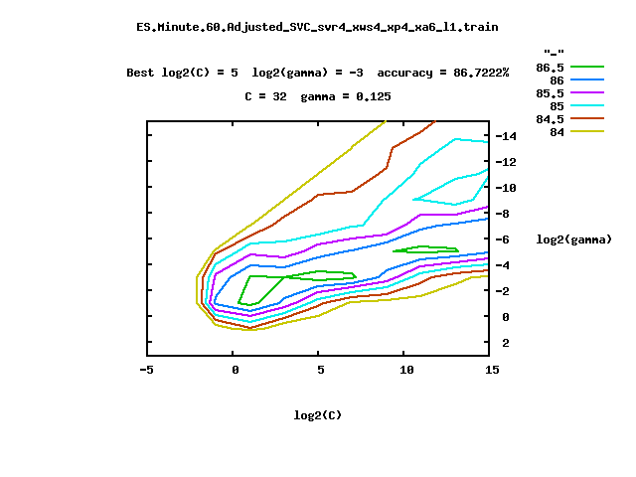
SVM algorithm
Testing set
SVM ( find the hyperplane !)
Parameter Optimization
(grid search)
X
?
Log₂Gamma
X
Log₂Cost

